Slide 1

JUDGMENTAL FORECASTING
Aathira puthenpurayil
P2736418
Tuesday group c

Slide 2
Forecasting process of forecasting upcoming trends or events using historical data and other pertinent information. It is an essential tool that both people and organizations use to make decisions and get ready for changes in the future.
Quantitative
Last period demand
Moving averages
Simple exponential smoothing
Multiplicative seasonal indexes.
Qualitative
Informed opinion and judgment
The Delphi method
Market research
Historical life-cycle analogy.
https://corporatefinanceinstitute.com/resources/financial-modeling/forecasting-methods/
Notes:
Forecasting: By revealing insights into the probable results of various scenarios and assisting people and organizations in getting ready for a variety of potential events and changes, forecasting plays a crucial role in decision-making and future planning.
For instance, a business might employ forecasting to foretell future product demand so that it can modify its output and inventory levels appropriately. To help guide policy choices, a government agency may use forecasting to anticipate future population or economic trends.
Depending on the particular issue at hand, the data's accessibility, and the resources and experience of the group or person forecasting, a particular forecasting technique will be chosen.

Slide 3
JUDGMENTAL FORECASTING
Judgmental forecasting is a technique for making predictions about upcoming circumstances or events based on the opinions of experts or other people with relevant knowledge and experience.
Relies on
Human intuition
Experience
Knowledge to generate forecasts
https://www.sciencedirect.com/science/article/abs/pii/S0169207006000501
Notes:
Judgmental Forecasting: It is standard practice to make predictions using judgment. When historical data is completely lacking, when a new product is being introduced, when a new rival joins the market, or when completely novel and unusual market conditions are present, judgmental forecasting is frequently the only viable option.
For instance, the Australian government was the first in the world to approve legislation in December 2012 prohibiting the use of company logos on cigarette packets and mandating that all cigarette packets be a dark green color. As there are no historical precedents, judgment must be used to predict the outcome of such a strategy.
Research in this area has shown that when the forecaster has both more timely and up-to-date information and significant subject knowledge then the accuracy of judgmental forecasting increases. A judgmental strategy can quickly adapt to these alterations, revelations, or events.

Slide 4
When is used?
1
Due to the lack of data, statistical methods are not relevant, and the only practical strategy is judgmental forecasting.
2
Data are accessible, statistical projections are made, and these are then modified based on judgment.
3
Data are available and statistical and judgmental forecasts are generated independently and then combined.
https://qiushiyan.github.io/fpp/judgmental-forecasts.html
Notes:
Judgmental predicting is used in some situations, according to Hyndman and Athanasopoulos (2018):-
When something cannot be mathematically explained, for starters.
Furthermore, it is employed when there is a lack of accurate statistical data about the item that permits the application of objective methods.
Thirdly, when there is no way to comprehend math. As an illustration, suppose there is no computer hardware, software, or knowledgeable staff.
Fourth, it is a good strategy for an emergency where a prompt choice is required.
As a result, there are four primary scenarios in which critical forecasting is applied.

Slide 5
Types
5
Expert opinion
Delphi method
Sales force composite
Customer surveys
Market research
Scenario planning
Historical analogy
https://corporatefinanceinstitute.com/resources/financial-modeling/forecasting-methods/
Notes:
Expert opinion: This involves gathering opinions and input from experts in the field to generate a forecast.
Delphi method: This is a structured approach to gathering expert opinions and using a series of questionnaires to reach a consensus on the forecast.
Sales force composite: This involves gathering input from the sales force or other front-line employees to generate a forecast.
Customer surveys: This involves gathering input from customers through surveys or other feedback mechanisms to generate a forecast.
Market research: This involves using market research data and analysis to generate a forecast.
Scenario planning: This involves considering multiple scenarios or potential outcomes and generating a forecast based on those scenarios.
Historical analogy: This involves using historical data and trends to generate a forecast.

Slide 6
Steps
6
1.Define the problem
2.Select the experts
3.Collect data
4.Formulate the forecast
5.Validate the forecast
6.Communicate the forecast
7.Monitor and update
https://qiushiyan.github.io/fpp/judgmental-forecasts.html
Notes:
Define the problem: Clearly define the problem or question that needs to be answered through the forecast.
Select the experts: Identify the experts or stakeholders who will be involved in the forecasting process.
Collect data: Gather any available data that could inform the forecast, such as historical sales figures or market research.
Formulate the forecast: Using the data and input from the experts, formulate a forecast that takes into account all relevant factors.
Validate the forecast: Review the forecast to ensure that it makes sense and is consistent with the available data.
Communicate the forecast: Present the forecast to stakeholders and explain the assumptions and reasoning behind it.
Monitor and update: Continuously monitor the forecast and update it as new data becomes available or circumstances change.

Slide 7
7 Best Practices
Use multiple sources
1
Validate results
2
Keep an open mind
3
Encourage participation
4
Document assumptions
5
Maintain flexibility
6
Track performance
7
https://www.vskills.in/certification/tutorial/qualitative-and-judgmental-forecasting/
Notes:
Use multiple sources: It's important to gather input from a variety of sources, such as subject matter experts, industry professionals, and market research data.
Validate results: Validate the results of the forecast against historical data or other relevant benchmarks to ensure that the forecast is accurate and reliable.
Keep an open mind: Avoid making assumptions or jumping to conclusions based on prior experience or biases.
Encourage participation: Encourage participation and collaboration among stakeholders to generate a more accurate and reliable forecast.
Document assumptions: Document all assumptions and inputs used in the forecast to ensure transparency and accountability.
Maintain flexibility: Recognize that the forecast is not set in stone and may need to be revised as circumstances change or new information becomes available.
Track performance: Monitor the performance of the forecast over time and adjust it as necessary to ensure accuracy and reliability.
By following these best practices, you can increase the accuracy and reliability of your judgmental forecasting analysis and generate more informed and reliable forecasts.

Slide 8
ADVANTAGES | DISADVANTAGES
Expertise | Bias
Flexibility | Limited Scope
Speed | Lack of transparency
Insights | Lack of accountability
Easy to Understand | Cost
Customization | Limited Use
https://www.armstrongeconomics.com/investments/judgmental-forecasting-and-fundamental-analysis/
Notes:
Advantages
Expertise: Judgmental forecasting draws on the expertise and experience of knowledgeable individuals, which can be especially valuable in situations where historical data is limited or not available.
Flexibility: Judgmental forecasting can be easily adapted to changing circumstances, making it a useful tool in dynamic and unpredictable environments.
Speed: Judgmental forecasting can be conducted quickly, which can be important in situations where decisions need to be made quickly.
Insights: Judgmental forecasting can provide valuable insights into complex problems that cannot be easily captured by statistical models.
Easy to understand: Judgmental forecasting can be communicated in a way that is easy for non-experts to understand, which can facilitate decision-making and stakeholder engagement.
Customization: Judgmental forecasting can be customized to fit specific needs and requirements, making it a versatile tool that can be applied across a wide range of contexts.
Disadvantages
Bias: Judgmental forecasting can be influenced by personal biases, opinions, and beliefs of the individuals involved, which can lead to inaccurate or unreliable forecasts.
Limited scope: Judgmental forecasting is often based on a small sample of experts or individuals with specific knowledge and experience, which may not reflect the broader range of perspectives and insights that could be obtained from a larger sample or more diverse group.
Lack of transparency: Judgmental forecasting can be opaque and difficult to replicate or validate, which can make it challenging to evaluate the accuracy and reliability of the forecasts.
Lack of accountability: Judgmental forecasting does not always have clear criteria or benchmarks for success, which can make it difficult to hold individuals or teams accountable for their forecasts.
Cost: Judgmental forecasting can be expensive, especially if it involves assembling a large group of experts or conducting extensive surveys or interviews.
Limited use: Judgmental forecasting is not always applicable or appropriate in all contexts, and may be less effective in situations where historical data or statistical models can provide more reliable forecasts.

Slide 9
Applications
Financial services
Healthcare
Technology
Retail
Energy
Manufacturing
https://www.vskills.in/certification/tutorial/qualitative-and-judgmental-forecasting/
Notes:
Financial services: The financial services industry relies heavily on judgmental forecasting to make investment decisions, forecast market trends, and anticipate regulatory changes.
Healthcare: The healthcare industry uses judgmental forecasting to predict disease outbreaks, forecast demand for healthcare services, and anticipate the impact of new drugs or therapies.
Technology: The technology industry uses judgmental forecasting to predict the impact of new technologies and anticipate future market trends.
Retail: Retailers use judgmental forecasting to forecast demand for products, anticipate consumer behaviour, and plan inventory and logistics operations.
Energy: The energy industry uses judgmental forecasting to forecast energy demand, anticipate future prices and supply, and plan investments in new technologies.
Manufacturing: Manufacturers use judgmental forecasting to forecast demand for products, anticipate changes in consumer preferences, and plan supply chain operations.
Overall, judgmental forecasting is used in many different industries to help organizations plan for the future, make informed decisions, and stay competitive in a rapidly changing business environment.

Slide 10
REFERENCES
10
Chapter 6 Judgmental forecasts | Notes for “Forecasting: Principles and Practice, 3rd edition” (qiushiyan.github.io)
Qualitative and Judgmental Forecasting - Tutorial (vskills.in)
Judgmental forecasting: A review of progress over the last 25 years – ScienceDirect
Judgmental Forecasting and Fundamental Analysis | Armstrong Economics
Forecasting Methods - Top 4 Types, Overview, Examples (corporatefinanceinstitute.com)

Slide 11
Discussion Group 1
Tuesday
Group C

Slide 12
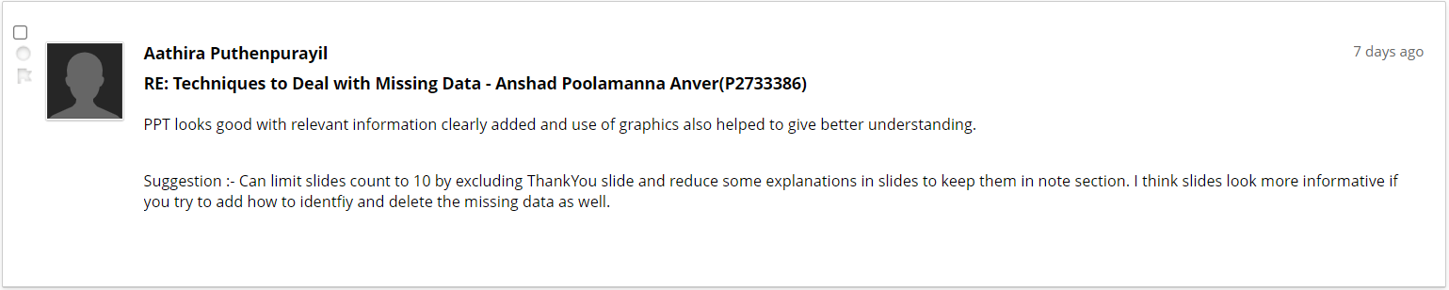
Feedback

Slide 13
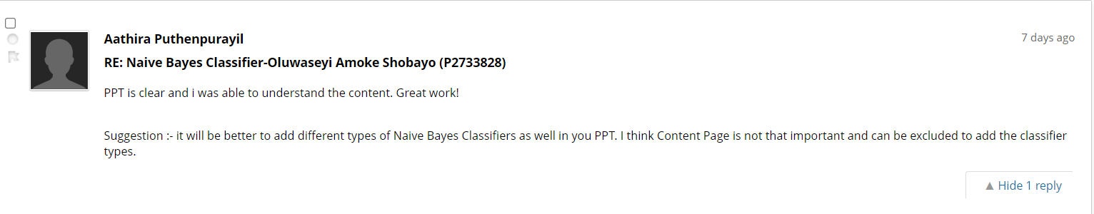
Feedback

Slide 14
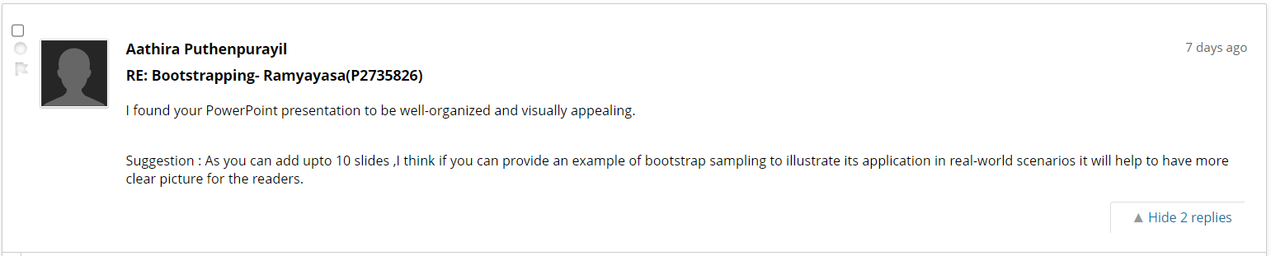
Feedback

Slide 15
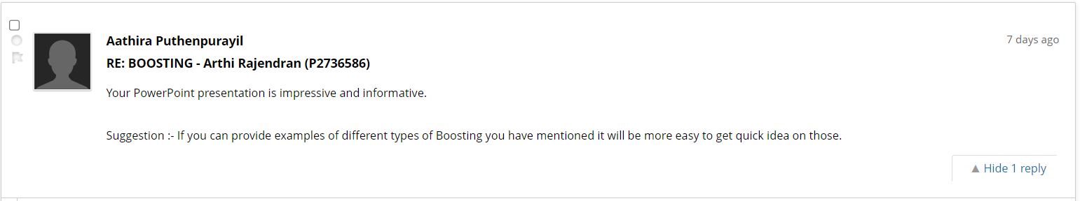
Feedback

Slide 16
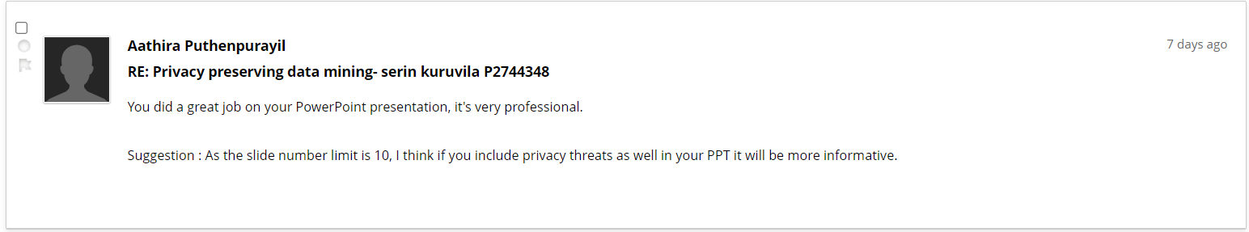
Feedback

Slide 17
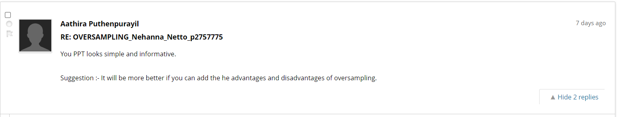
Feedback

Slide 18
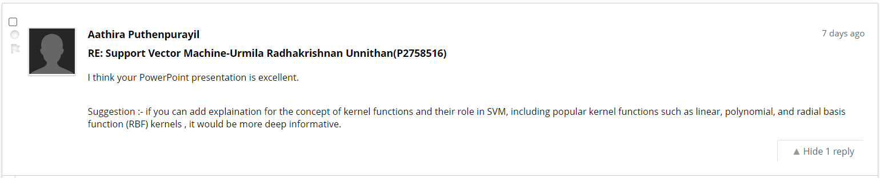
Feedback

Slide 19
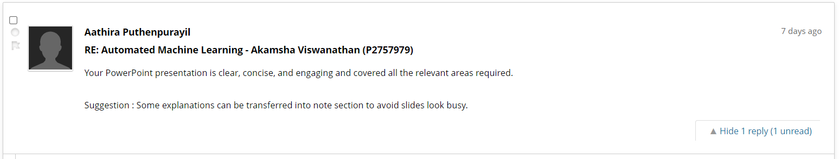
Feedback

Slide 20
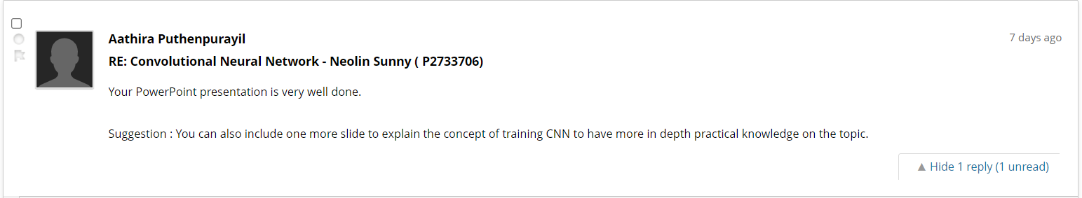
Feedback

Slide 21
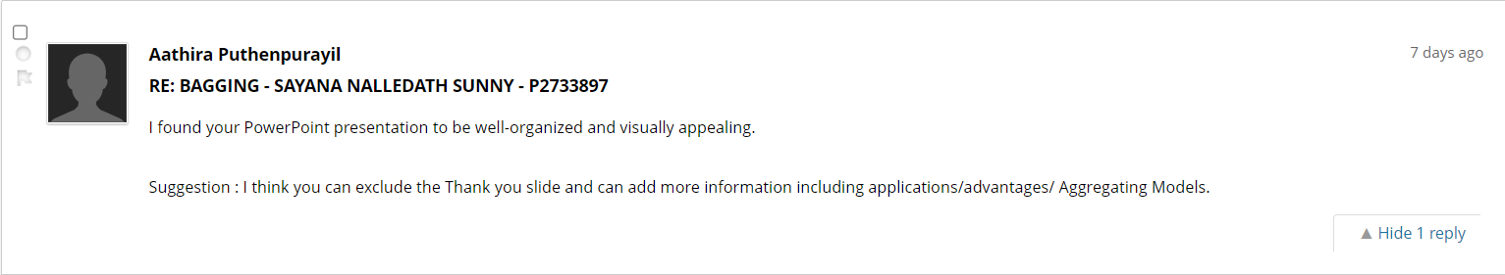
Feedback

Slide 22
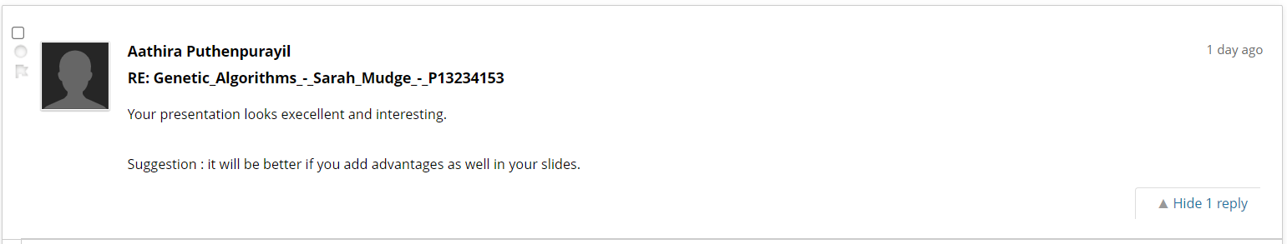
Feedback

